Slide 1
WMSURE
William and Mary Scholar Undergraduate Research Experience

Slide 2
PleASE SIGN IN
We’ll make sure you’re added to the listserv

Slide 3
What are We Doing?
The William and Mary Scholars Undergraduate Research Experience is being created to increase research opportunities for YOU.
A hallmark of the WMSURE will be faculty mentor training that will serve both the faculty and students and workshops geared to faculty, students, and faculty/student teams that will be held throughout the year.

Slide 4
Who We Are
Joel Schwartz (Dean of Interdisciplinary Studies and Director of the Charles Center)
Anne H. Charity Hudley (Assistant Professor, English, Linguistics, Africana Studies; William & Mary Professor of Community Studies)
Cheryl Dickter (Assistant Professor, Psychology, Neuroscience)
Chon Glover (Assistant to the President)
Darlene Dockery (Graduate Assistant; Gifted Education)

Slide 5
Faculty Mentors
Faculty mentors will:
  Educate other faculty and students about WMSURE
  Lead and attend workshops
  Be knowledgeable about funding opportunities in your discipline
  Supervise your research

Slide 6
WMSURE Faculty Fellows
Artisia Green: Theatre, Speech, Dance
Jacquelyn McLendon: English, Africana Studies
Angela Banks: Law School
Paul Heideman: Biology
Christopher Howard: Government, Public Policy
Sharon Zuber: English, Film Studies, Writing Center
Christopher Ball: Psychology
Paul Bhasin: Music

Slide 7
WMSURE Graduate FEllows
Darlene Dockery PhD, Gifted Education
Sean Kelleher MPP, Public Policy
Office hours on the WMSURE website

Slide 8
WMSURE PSA
http://www.wm.edu/sites/scholarships/peerscholarshipadvisors/index.php
Sites » Scholarships » Peer Scholarships Advisors Peer Scholarship Advisors
Charles Center Peer Scholarship Advisors (PSAs) hold weekly office hours in the Charles Center and are also available for consultation by appointment. Meet with them to talk about national awards, Charles Center summer scholarships, oral and poster presentations, etc.
We are also more than happy to review materials for scholarship applications such as personal statements and project proposals. If you would like peers to edit the grammar and style of your materials, we recommend that you schedule an appointment at the Writing Resources Center in Swem.
Finally, PSAs offer Scholarships 101 each EVERY WEEKDAY at TBA. Stop by and find out how to get started with the scholarship process!
PSAs can discuss all kinds of awards, and are more than ready to come talk to your group (residence halls welcome!) or organization. Simply fill-out this form so that we can begin to arrange a presentation.

Slide 9
PSA Office HOURS
PSA OFFICE HOURS FALL 2012
MONDAYS
9:00-11:00 Mike Schilling
1:00-3:00 Johnathan Maza
TUESDAYS
9:00-11:00 Petar Yanev
11:00-1:00 Libby Hennemuth
WEDNESDAYS
1:00-3:00 Allyson Zacharoff
3:00-5:00 Jeff Rohde
THURSDAYS
10:00-12:00 Taylor Lain
12:00-2:00 Brett Evans
FRIDAYS
2:00-3:30 Jeff Rohd

Slide 10
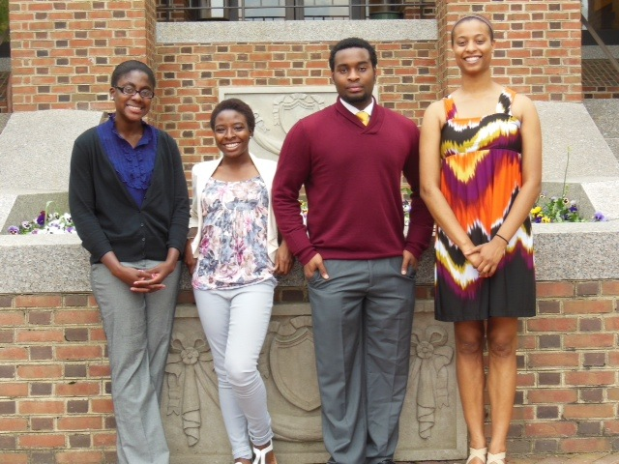
WMSURE ACHIEVEMENTS-Honors
Kenay Sudler - High Honors-Linguistics
Jerome Carter - High Honors-Africana Studies
Danielle Greene - High Honors- Interdisciplinary Studies-Education
Adrian Bravo-Honors
Psychology

Slide 11
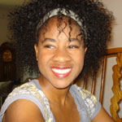
WMSURE achievements
Marissa Beale ‘14: http://www.voanews.com/audio/audio/178464.html
http://www.wm.edu/as/charlescenter/scholars/wmsure/currentstudents/beale_marissa.php

Slide 12
WMSURE achievements
"I was on the Dean's List this Spring, received an Upperclass Monroe grant for my research on Americans moving out of their childhood homes, and was given the position of Undersecretary of Socioeconomic Affairs in the Student Assembly for next year, marking my second year working on diversity issues in student government."
"I got a A in calculus which I was extremely proud of myself for! I also did not get a C in ANY classes first or second semester which was my goal for freshman year."
"Graduating Magna Cum Laude. Being awarded High honors on my thesis, "Accent, Attitudes, and the Speech-Language Pathologist" Being accepted to a Masters of Science program in Speech-Language Pathology at Teachers College, Columbia University. Being elected to Phi Beta Kappa."
"I was the only freshman girl originally selected to be in W&M’s production of Cabaret which was a fabulous experience. I will also be the secretary for the Theatre Student Association next year also!"

Slide 13
Highlights for the YEar
Lunches!
Events by more faculty!
Guest Speakers: Dr. Tyrone Hayes and Dr. Lawrence Jackson
More GRE prep
Reading room in Blow

Slide 14
Exciting upcoming wmsure events
Sep. 11th, 12pm - 2pm, Campus Center
  Lunch and Remembrance: Come ask questions about WMSURE and remember those who perished and lost on 9/11/01.
Sep. 13th, 5pm - 7pm, Writing Resource Center
  Time & Energy Management: This workshop will focus on strategies for managing school, work, and extracurricular activities.
Sep. 18th, 12pm - 2pm, Campus Center
  Time & Energy Management Lunch: Come discuss what we learned at the time and energy management workshop with Prof. Charity Hudley.

Slide 15
More events!
Sep. 25th, 5pm - 7pm, Writing Resources Center
  Writing Across Disciplines
Sep. 28th, 4pm - 5:30pm, Tyler Hall, 2nd Floor Lobby
  Family Weekend Reception: Join us for a meet-and-greet with the co-directors of WMSURE (Prof. Anne Charity-Hudley and Prof. Cheryl Dickter) and as a showcase of research by WMSURE students.
Oct. 2nd, 12pm - 2pm, Campus Center
  Finding a Faculty Research Mentor

Slide 16
More events!
Oct. 4th, 12pm - 2pm, Blow Hall, Counseling Center
  A Conversation About Solo Status and Stereotype Threat at W&M: Join Warenetta Mann and Patrick Hudgins of the WM Counseling Center for a conversation on solo status and stereotype threat on the William and Mary campus.
Oct. 11th, 5pm - 6:30pm, Writing Resource Center
  Beating the New GRE: Representatives from Kaplan will be here to give you tips on how to best prepare for the new GRE.

Slide 17
UPCOMING OPPORTUNITIES
NASA Grants- Info session 1st week of October
http://vsgc.odu.edu/sf/Bridge/

Slide 18
Securing an Advisor/Mentor
How do students convince faculty to work with them?
How does that first email look?
  Make sure you identify yourself as a WMSURE scholar (and any other scholar if applicable)
  Identify other faculty that you have worked with
Find out about office hours and the faculty member’s schedule

Slide 19
That first meeting
Knowledge about what the advisor does and has done
Making sure you know what classes they teach
Idea of what types of skills you have: resume, CV, or summary
Some professors have applications
http://wmpeople.wm.edu/asset/index/cldickter/researchassistantapplication8
Sometimes you meet with the lab manager

Slide 20
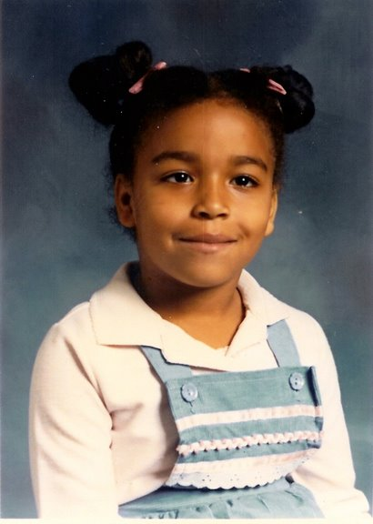
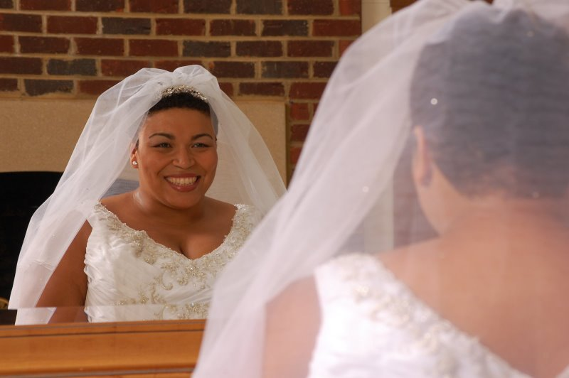
About me

Slide 21
Courses I TEach
CMST 250/ENGL 464: African-American English
CMST 351: Community Based Research Methods: The Language of Engagement
INTR 480: Linguistics Lab
ENGL 220/ANTH 204: Study of Language

Slide 22
My Research Projects
http://annecharityhudley.com/researchopportunities/
New research on transition from high school to college!
Camp Launch & Higher Achievement

Slide 23
WE DO ENGLISH
Opportunity #1: Book Research Assistants
When author Toni Morrison gave a Nobel Lecture after accepting a Nobel Prize for Literature in 1993, she chose to focus on how language is essential to humanity. “We die. That may be the meaning of life,” Morrison said. “But we do language. That may be the measure of our lives” (“Nobel lecture,” para 21).
Building on Morrison’s themes, our book, “We Do Language”: English Language Variation in the Secondary English Classroom,presents specific strategies and models for the greater integration and application of language variation-related concepts, skills, and strategies in the secondary English classroom. The book draws on and extends the generalized concepts of Prof. Charity Hudley and Prof. Christine Mallinson’s first book, Understanding English Language Variation in U.S. Schools, by presenting even further contextualization for the need to integrate linguistically-informed pedagogy into secondary English classrooms. The true strength of the book are the vignettes and materials that in-service secondary English educators have developed and shared with us through interviews, focus groups, and other correspondence; these vignettes and materials will directly attest to the value of infusing language variation into secondary English classrooms.
Interns will help gather and organize material from English Educators and participate in workshops with educators in conjunction with the Capstone English Academy: http://education.wm.edu/centers/sli/surn/Capstone/index.php
Graduate Student: Kerri Mahoney, Kerri Mahoney krmahoney@email.wm.edu, doctoral students in curriculum and instruction (Secondary English) at the WM School of Education

Slide 24
Language in STEM CLASSROOMS
Opportunity #2: NSF Collaborative Research: Assessing the Results of Sociolinguistic Engagement with K-12 STEM Education in Maryland and Virginia Public and Independent Schools
Prof. Anne Charity Hudley (WM) and Prof. Christine Mallinson (UMBC), have been awarded a grant from the National Science Foundation (NSF) to study how cultural and social language patterns affect learning and student assessment in STEM (Science, Technology, Engineering and Mathematics) classrooms.
Charity Hudley and Mallinson will receive $171,928 over a three-year period to work with 60 K-12 educators in Baltimore, Hampton Roads and Richmond. We will assess educators’ knowledge of and their responses to language variation, particularly among African-American students. The two researchers will also work with participants to create linguistically informed materials for classroom use.

Slide 25
Language in STEM CLASSROOMS
NSF award notice: http://www.nsf.gov/awardsearch/showAward.do?AwardNumber=1050938
Interns will help gather and organize material from STEM Educators and participate in workshops with educators. We will also work with STEM students this summer in conjunction with The Center for Gifted Education.
Graduate Students: Darlene Dockery dddockery@email.wm.edu, doctoral student in Gifted Education at the WM School of Education, and Inte’a DeShields idesh1@umbc.edu, doctoral student in Literacy, Language, and Culture at UMBC.
Read more here: http://www.wm.edu/news/stories/2011/professor-receives-nsf-grant-to-study-language-patterns-in-stem-classrooms-123.php

Slide 26
WMSURE/Career and College
SURN Leadership Academies: Visible Teaching, Assessing, Learning, and Leading (VTALL 2.0) will offer professional development to middle and high school teacher leaders as well as administrators (N=400) in the SURN
27-member school division partnership. College and Career Readiness Skills (CCRI) will be developed within high school English classes of participants. Adolescent Literacy Leadership Teams will establish a common language and strategy set within the schools. Administrators will engage in discussion about supporting effective instruction. A common thread is the focus on formative feedback. The grant proposes to address the teacher need for professional development emphasizing strategies that support lifelong student learning.
Share your insights and experiences!

Slide 27
STAND UP AND BE COUNTED!
Please take our surveys!
Answer any questions you feel comfortable with!
We’ll be sending them around soon with incentives to take them!

Slide 28
PleASE SIGN IN
We’ll make sure you’re added to the listserv

Slide 29
About me: Cheryl dickter
Psychology Department, Neuroscience Program
Research - I use social cognitive neuroscience methods to study:
  how the processing of social categories such as race and gender occurs, and how it is influenced by contextual info like stereotypes
  how exposure to smoke and alcohol, either through primary or secondary exposure, affects implicit responses to smoking and alcohol-related stimuli

Slide 30
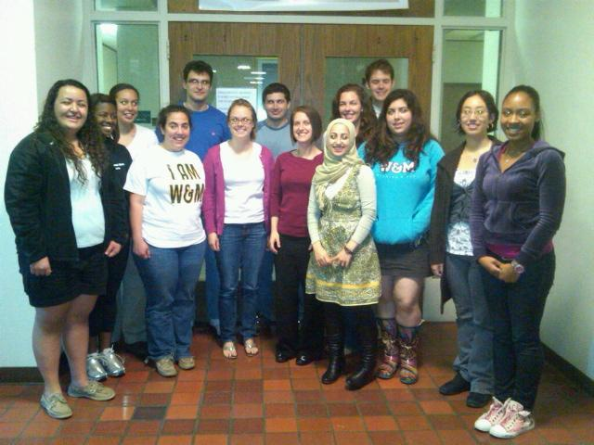
W&M Social cognition lab

Slide 31
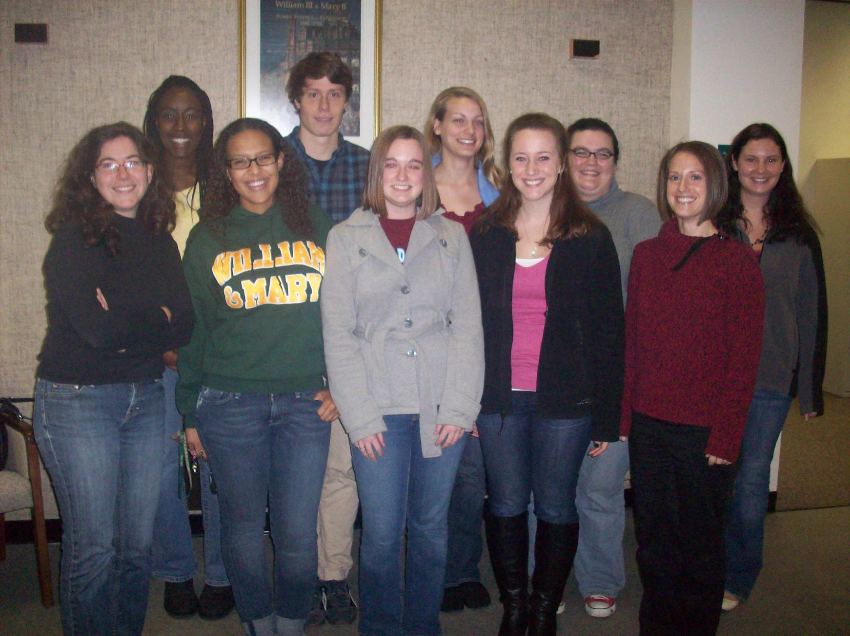
W&m addiction lab

Slide 32
Classes I teach
Introduction to Social Psychology
Statistics
Advanced Research Methods
Seminar in Stereotyping and Prejudice
Proseminar in Social Psychology (graduate)

Slide 33
What is research?
We want to hear from you!

Slide 34
What is Research?
What are you most interested in in the world?
What pisses you off; what would you like to change?
What would you like to create?
What would you like to spend your time doing?
What are major trends in academic right now, in industry, in the media?

Slide 35
Why Research Rules!
For students:
  Get money/academic credit to research issues that you are interested in!
  Find out if research is for you
  Increase your chances of getting into graduate school/getting a great job
For faculty:
  Faculty like working with students!
  We get credit on our merit forms!

Slide 36
Independent Study
Various requirements by department/program
Check on the ones that you are interested in now to plan for the future!

Slide 37
Departmental Honors Program
The Departmental Honors Program provides qualified students the opportunity to complete a two-semester, six-credit research project under the supervision of a faculty advisor.
  Entails a thesis and oral defense
  Completing an Honors project can be one of the most academically rewarding experiences of a student's undergraduate career

Slide 38
Research Can Happen Without a Grant or Fellowship
Summer housing
Working part time
Classes
Independents studies done in summer count for fall

Slide 39
Internal Funding
http://www.wm.edu/as/charlescenter/undergrad_research/index.php

Slide 40
WMSURE Grants
Research expenses
Conference travel
Provide a detailed budget and a justification for expenses should be provided. Funds may be requested in amounts up to $1000.
To apply, email 1000-word description, CV, and application to cldickter@wm.edu

Slide 41
WMSURE Grants & Interns
Applicants must have attended a minimum of three WM SURE events in the semester of the application, or the previous semester.
The applicant must have a letter of support written by a faculty mentor at W&M.
The applicant must demonstrate that he or she has also applied to and/or received funding from another internal granting agency to support this project (e.g., Charles Center, OCES, Reves Center, Sharpe, Student Assembly Conference Funds,).

Slide 42
Integration With Other Scholars Programs On Campus
Murrray, Monroe, & Sharpe
Like Monroe & Sharpe we’re hoping long term for different points of entry
Many events will be “sponsored by WMSURE” instead of just only “for WMSURE”

Slide 43
WM SURE Student Workshops/Events
https://events.wm.edu/calendar/upcoming/wmsure
Notes:
Planning for success in the first-year of college and beyond
• Investigating the question: “What is research?”
• Choosing majors and research questions
• Finding rewarding research experiences at W&M
• Learning from faculty and staff from underrepresented groups at W&M and elsewhere
• Navigating the graduate school search

Slide 44
Your SUGGESTIONS?

Slide 45
PleASE SIGN IN
We’ll make sure you’re added to the listserv

Slide 46
Questions?
Any questions, about ANYTHING!!
Prof. Anne Charity Hudley acharityhudley@wm.edu
Prof. Cheryl Dickter cldickter@wm.edu

